Slide 1
Regional Disparity in the Political Transition Processes of Former Soviet Republics Zixuan Li Advisor: Prof. Mark Jones July 14, 2025
Pioneer Academics
Comparative Political Institutions of the World
Notes:
Good [morning/afternoon]. Today, I’ll be presenting my research on how the former Soviet republics followed different paths of political development after 1991, and why those differences show clear regional disparities.

Slide 2
Content
Introduction
Regional Analysis & Case Studies
Analysis
Notes:
This presentation has three parts. First, an introduction to the topic; second, a comparison of the three main regions using freedom scores and case studies; finally, a concluding analysis of the factors that lead to the regional disparities.

Slide 3
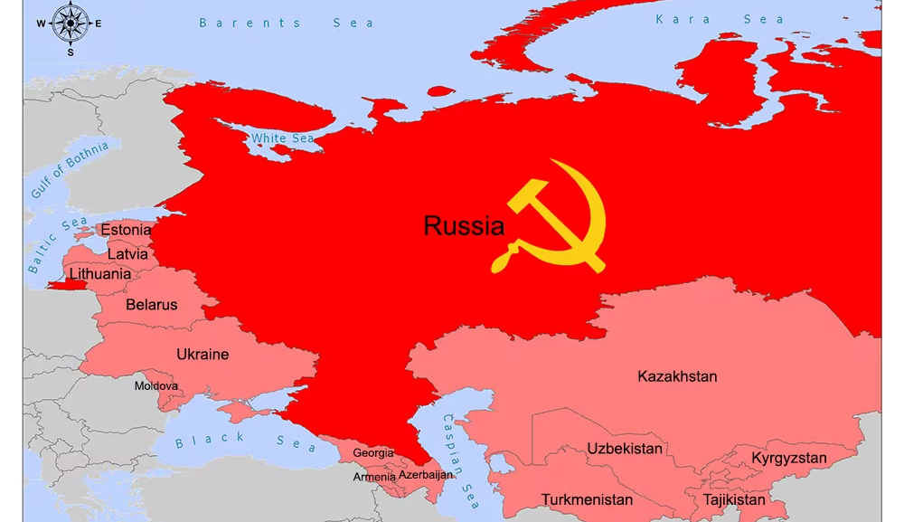
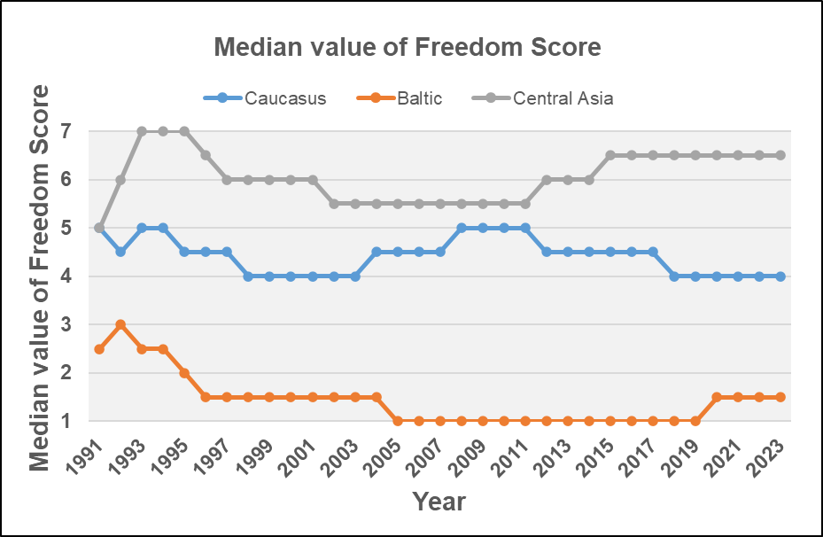
Introduction
What led to the divergent transition paths?
Baltic: liberal democracies
Caucasus: hybrid regimes
Central Asia: authoritarian states
Notes:
As you can see, this is a map of the 15 republics that comprised the Soviet Union. However, after the collapse of the Soviet Union, the world witnessed a great variance in their paths of political transitions. The Baltic states became members of the freest countries in the world; on the other hand, the Central Asian states remained among the most authoritarian countries. Other countries, represented by the Caucasian states, became hybrid regimes with mixed levels of democracy. As you can discover, countries in the same region tend to share similar progress of democratic development, while different regions show great disparities in their political transition processes. Therefore, the goal of this study is to focus on these three regions and the countries within, display the regional disparities, and explore the underlying factors.

Slide 4
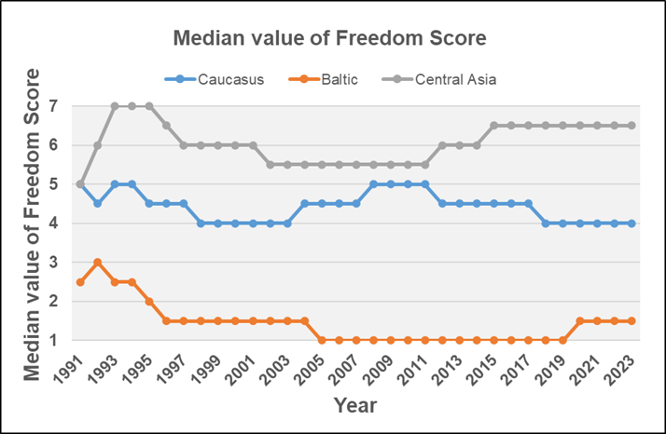
Regional Analysis & Case Studies
The Baltic Region
Case of Lithuania
The Caucasus Region
Case of Armenia
Central Asia
Case of Uzbekistan
Notes:
The goal of the regional analysis is to recognize the distinct transition patterns among the three regions. Therefore, the Freedom House data of the countries will be presented in regional clusters and analyzed as an indicator of the degree of democracy. Also, there will be a case study for each region to specifically explain the trends.

Slide 5
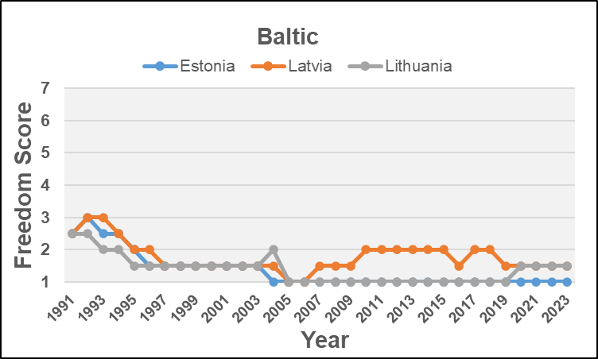
The Baltic Region
Trend
Low initial freedom scores
Stable democracy
Free
Factors
Successful independence movements
Strong national identities
Proximity to Western Europe
Notes:
Among the fifteen former Soviet republics, the Baltic states are the ones with the highest degree of democracy. As displayed in the figure, in 1991, the year when the Soviet Union collapsed, the freedom scores of the three countries were already 2.5, which put them in the “Free” category according to Freedom House. In the following few years, the Baltic states became freer as their freedom scores decreased to 1.5. From 1991 to 2023, their freedom scores never exceeded 3, which serves as strong evidence of democratic consolidation in the region. Three main factors contributed to the fast and successful democratic transition in the Baltic states: the success of grassroot movements, strong national identities, and their proximity to Western Europe.

Slide 6
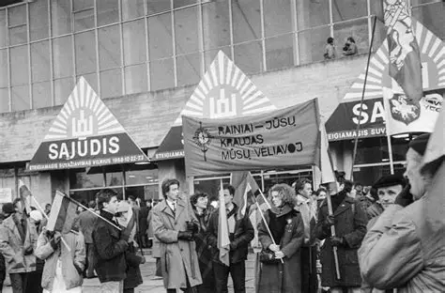
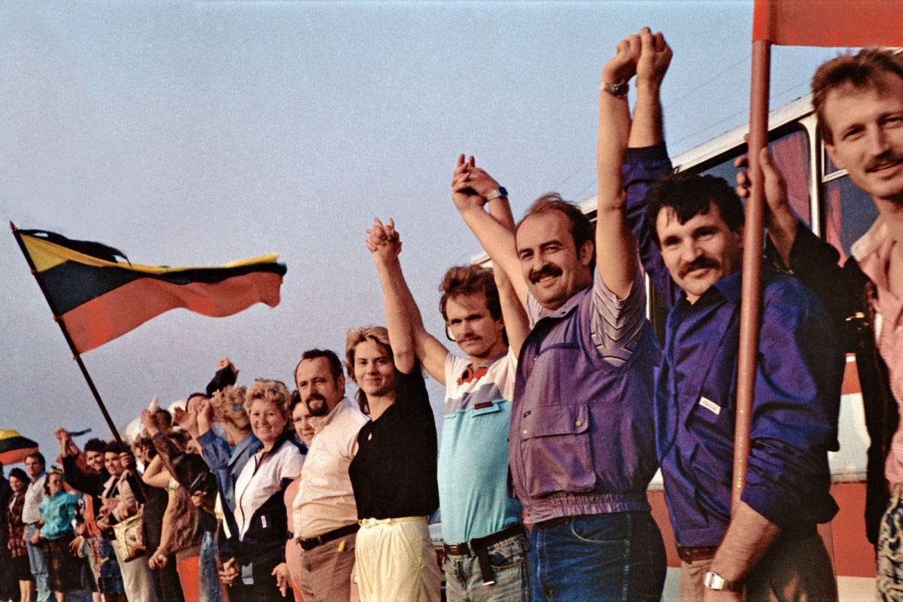
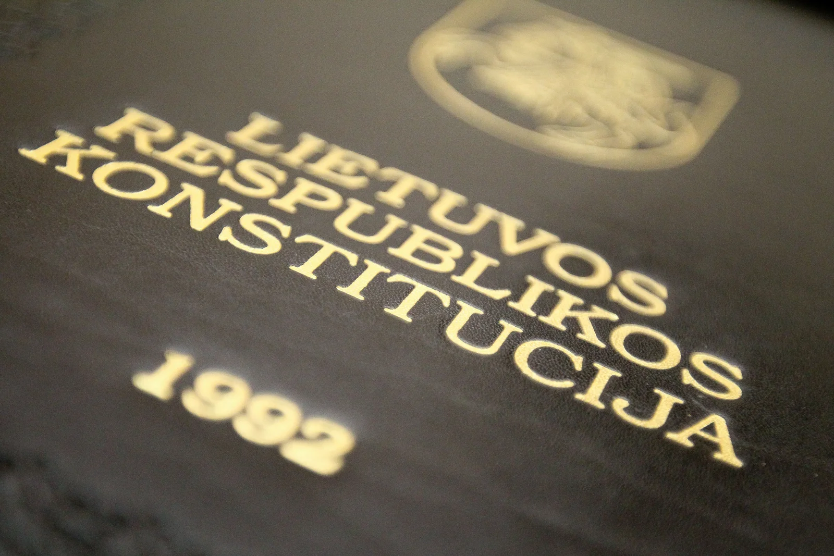
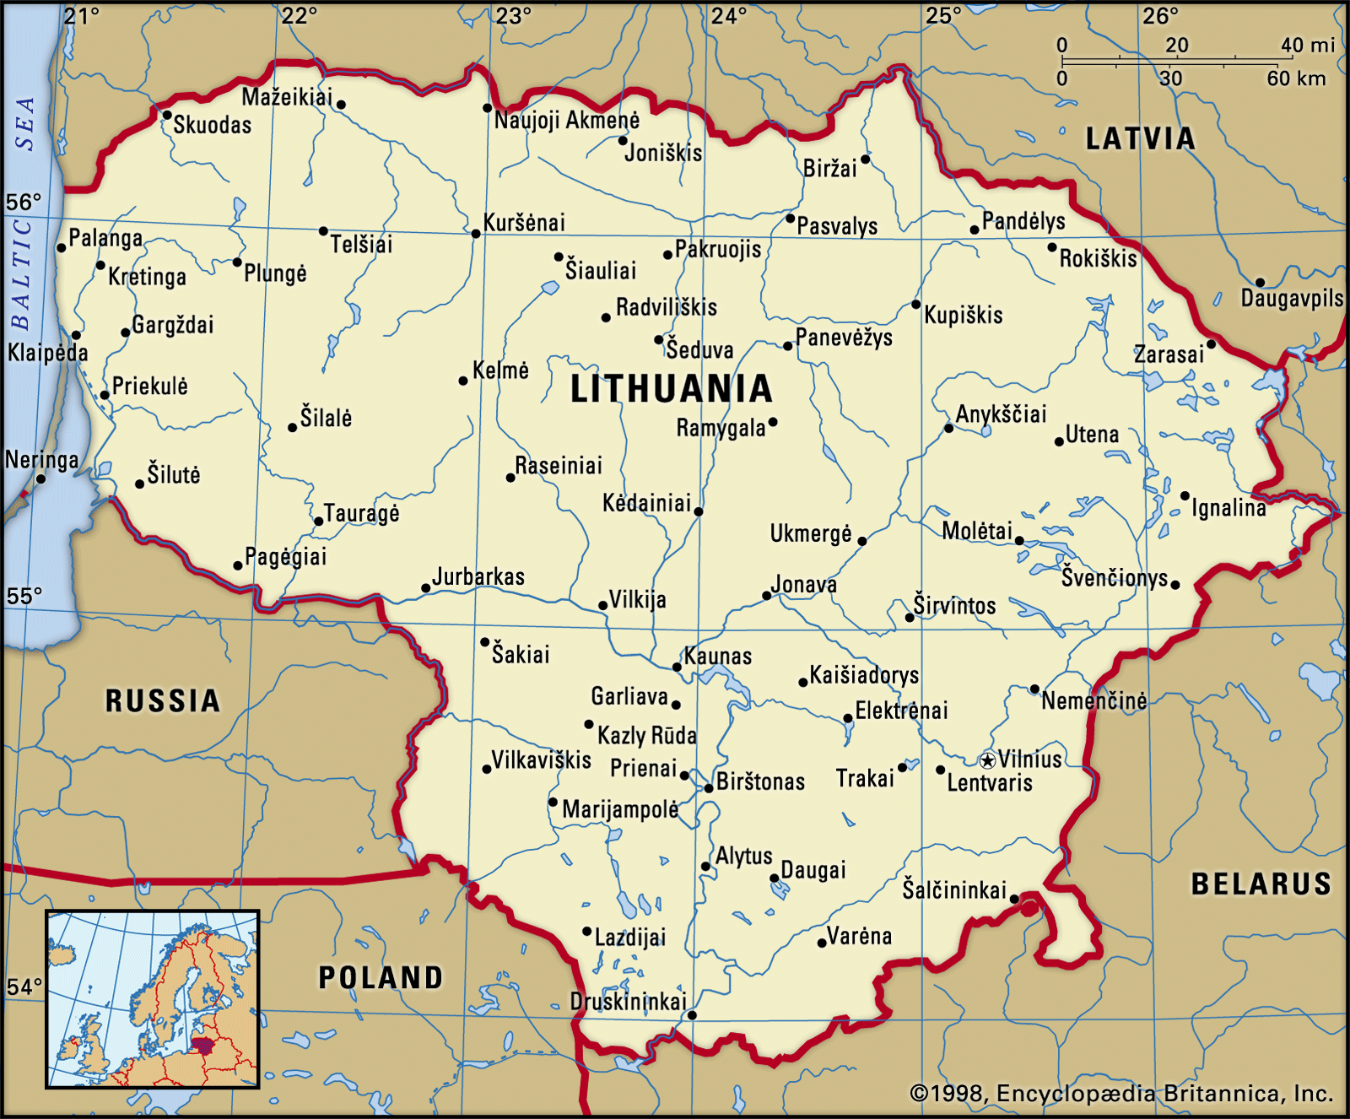
Case of Lithuania
Strong national identity
Historical statehood and independence
Independence movements
Early democratic practice
1992 constitution
Peaceful power transition
Robust civil society
High turnout rates
Government legislation
Notes:
The representative case of the Baltic region is the transition of Lithuania. The long history of statehood and experience of independence between 1918 and 1940 cultivated a strong national identity that fostered both the independence movements and the democratization process. Among all the independence movements, the Sajūdis movement became a vital force that included intellectuals, reformers, and social activists. Its leader, Vytautas Landsbergis, became the first president of Lithuania. In 1992, the first democratic constitution was ratified through a referendum, marking the establishment of a democratic system. In the same year, the first peaceful transfer of power was conducted via free election. In 2004, Lithuania joined the European Union, opening a new chapter in its democratic progress.
Besides political progress, Luthuania’s civil society was also robust. Most elections in Lithuania saw turnout rates of over 50%, and the early elections in 1991 and 1992 even achieved turnout rates of 70%. Furthermore, the government has taken active measures and established legislation that facilitates the growth of NGOs since independence. The right to freedom of association is protected in Lithuania’s constitution, and the establishment of an NGO requires only two people. There is also a legal code that allows citizens to designate 2% of their income taxes to a selected NGO or public institution, which has become an important source of revenue for NGOs.

Slide 7
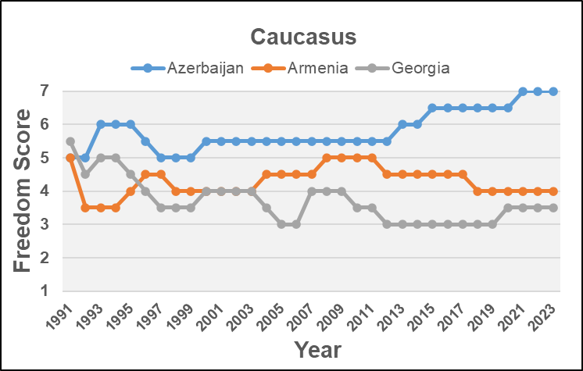
The Caucasus Region
Trend
Medium freedom scores
Constant fluctuations
Partly free
Factors
Ethnic tensions
Territorial disputes
Complicated geopolitical situation
Notes:
The freedom scores of countries in the Caucasus region are clearly divergent from those of the Baltic states. From this figure, it is observed that the freedom scores of the three countries never fell below 3, and the constant fluctuation indicates an unstable political environment in the region. Among these countries, Armenia and Georgia exhibited semi-democratic features and have been categorized as “Partly Free” countries since 1991, while Azerbaijan is more authoritarian and is categorized as “Not Free” most of the time, according to Freedom House. Despite this, the three countries still have lower freedom scores than the authoritarian countries in Central Asia, which is the reason that they can all roughly be counted as semi-democratic countries. Similar to the Baltic states, however, historical factors and geopolitical environment also have substantial impacts on the political transition in the region. The contested ethnic tensions and territorial disputes in the Caucasus, along with more complicated geopolitical situations, prevent the Caucasus states from transforming into fully democratic regimes.

Slide 8
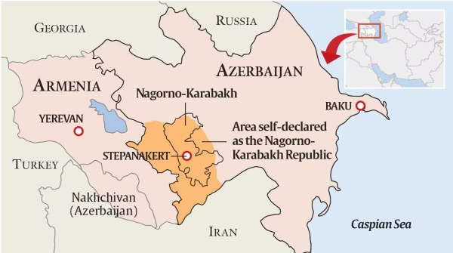
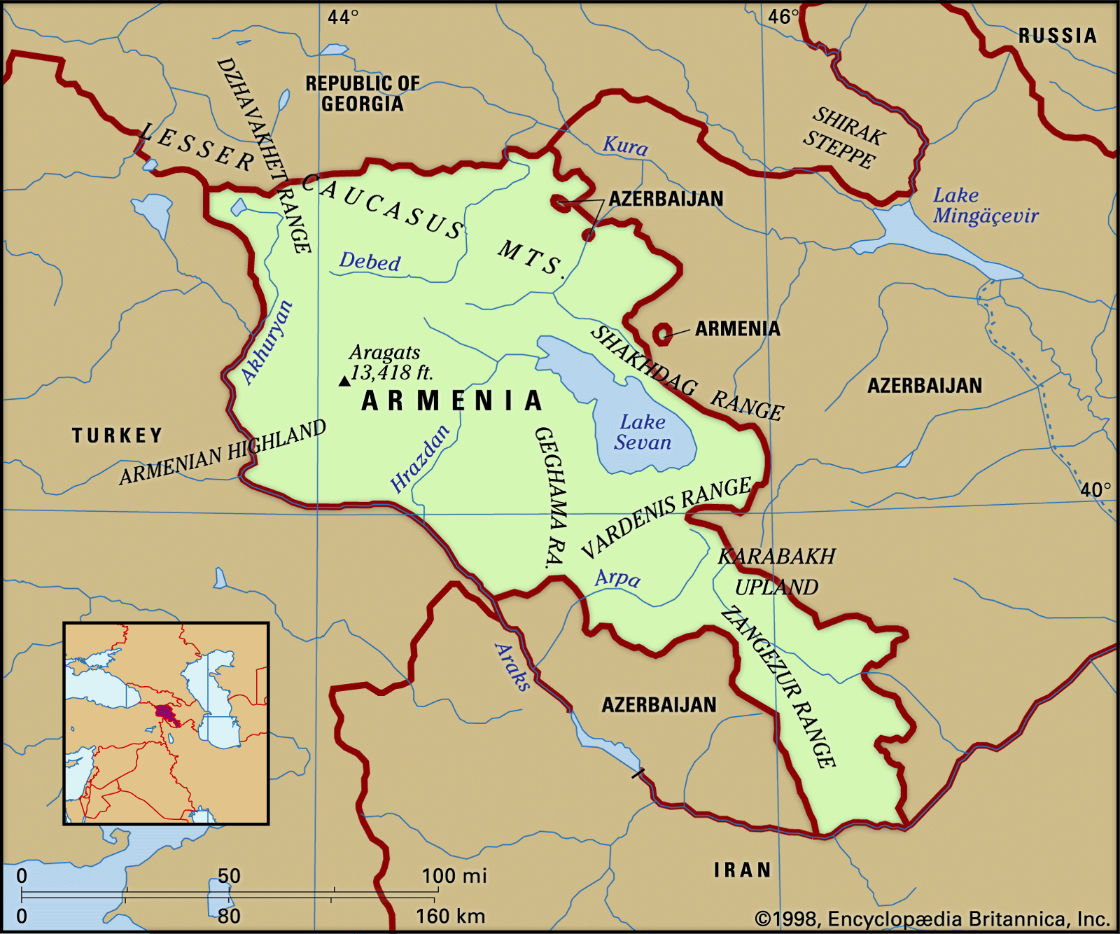
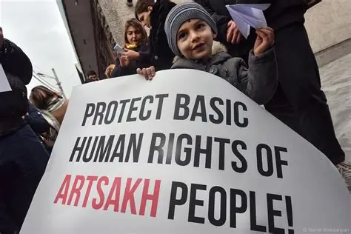
Case of Armenia
Nationalistic drive
Nagorno-Karabakh conflict
Locomotive of democratization
Instability and strong presidential authority
Moderately developed civil society
A large number of NGOs
Low level of political participation
Weak influence
Notes:
Like other Caucasian states, Armenia’s political transition process was complex due to the contested ethnic distribution in the Caucasus region. Since independence, nationalism in Armenia has been both closely related to democratization and, at the same time, hindered the pace of political reforms. Nagorno-Karabakh is a region under Azerbaijani rule but inhabited by a significant number of Armenians, and the nationalistic movement to free the area fostered civic engagement and contributed to the country’s early democratic aspirations. The first president of Armenia, Levon Ter-Petrosyan, was the leader of the Karabakh Committee. However, the nationalistic fervor in Armenia also had negative impacts on democratic developments. Instability contributed to a political culture centered around charismatic leadership and personal authority, resulting in the concentration of power in the presidency and the gradual erosion of the role of parliament.
The Armenian civil society is described as “moderately developed,” with a relatively strong level of organization but with weak impact and low civic engagement. The civil society organizations have developed rapidly in Armenia since 1991. Every year, hundreds of NGOs emerge, and there were 3,552 registered NGOs in Armenia by 2013. However, many NGOs have a weak influence and struggle to survive. They also don’t receive much support from the citizens.

Slide 9
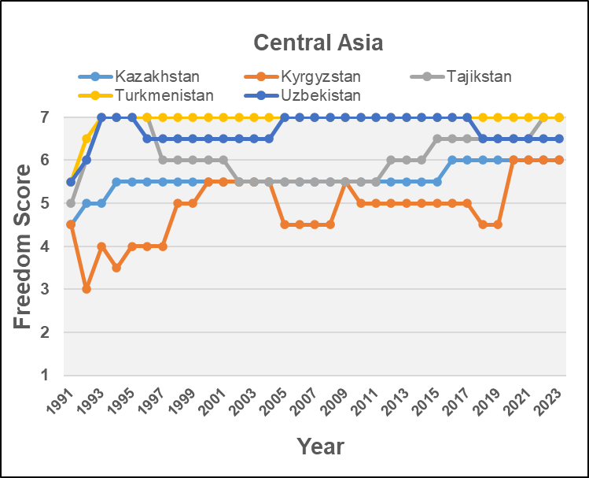
Central Asia
Trend
High freedom scores
Continued authoritarianism
Not free
Factors
Persisting Soviet legacy
Underdeveloped civil society
Distance from Western democracies
Notes:
Different from both the Baltic region and the Caucasus region, the five countries in Central Asia experienced minor political transformation in the past few decades and remain authoritarian countries today. This trait also reflects in their freedom scores. As the figure exemplifies, from 1991 to the present, except for Kyrgyzstan, which has had a relatively low freedom score and occasionally fallen in the “Partly Free” category, the rest of the five countries have all been categorized as “Not Free” according to the standards of Freedom House. The extreme case of Turkmenistan has even maintained the highest freedom score, which indicates the least degree of freedom, ever since 1993. The persistence of authoritarian rule in the region is the product of several factors, including the persisting Soviet legacy, the underdevelopment of civil society, and its distance from established Western democracies.

Slide 10
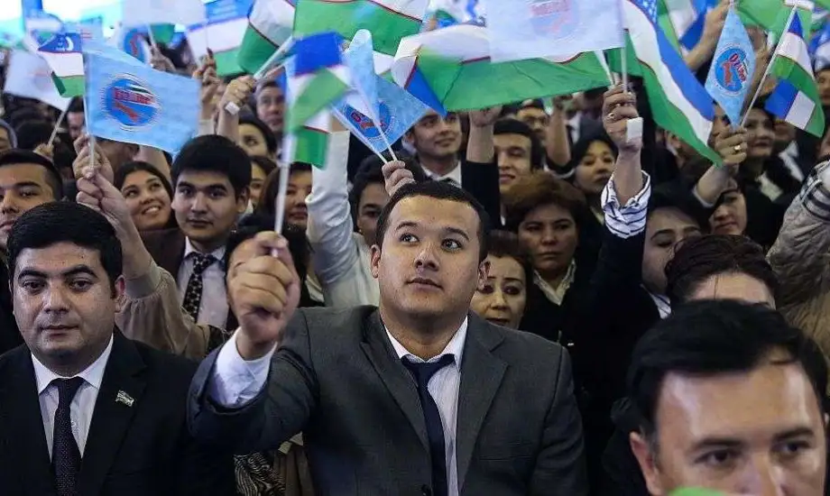
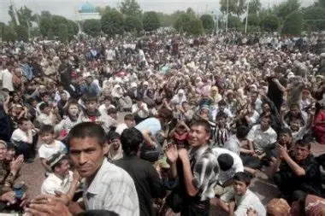
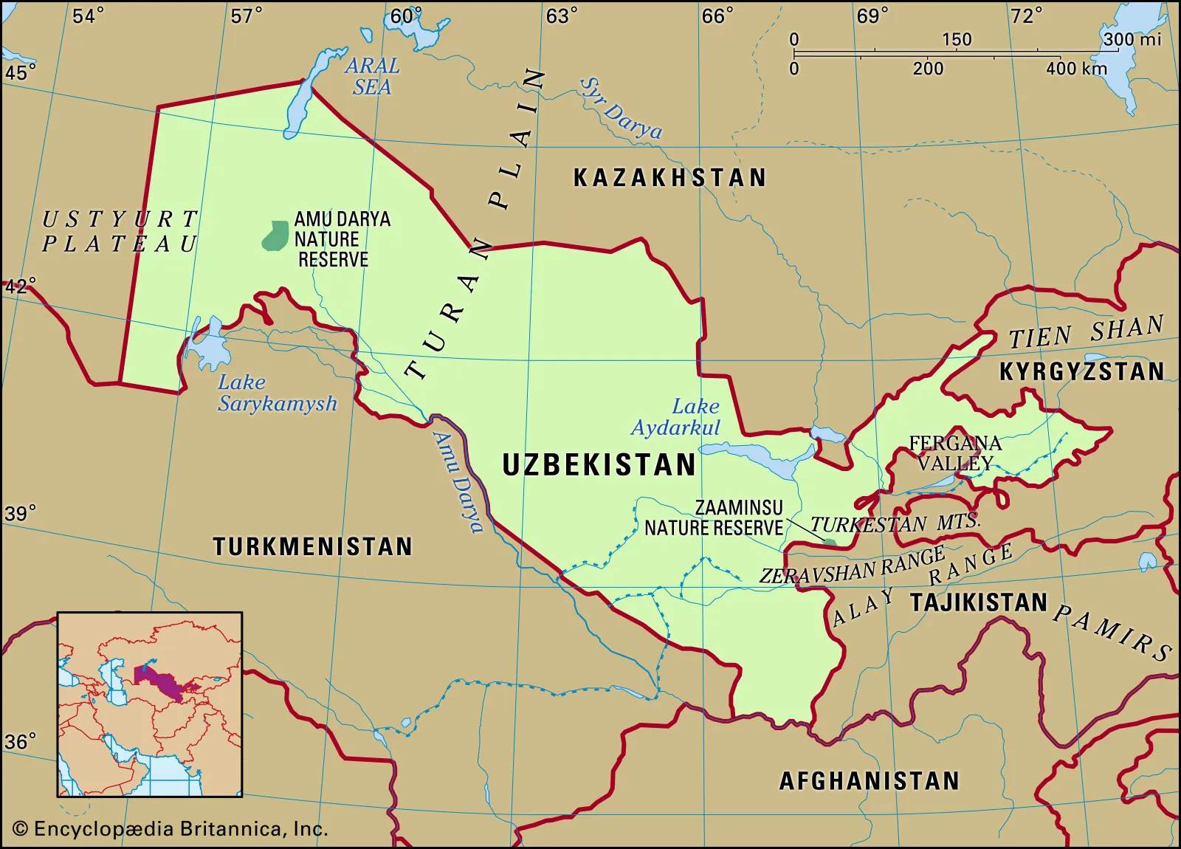
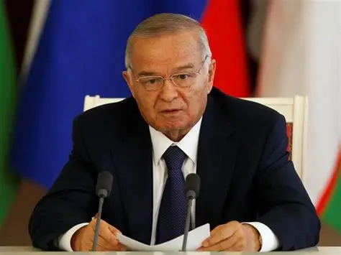
Case of Uzbekistan
Unbalanced power distribution
Weak checks and balances on the president
Power controlled by former elites
Suppressed opposition
2005 Andijan Uprising
Weak civil society
Uncompetitive elections
Expelled NGOs
Censored press
Notes:
Uzbekistan represents a typical case of political transition among the Central Asian states. The power distribution in Uzbekistan is highly unbalanced as the parliament and judiciary are highly subordinate to the president. Political power is dominated by a few elites from the former Communist Party. The first president of Uzbekistan, Islam Karimov, was the former First Secretary of the Communist Party. In order to consolidate his personal rule, he frequently suppressed opposition and dissenters. The most extreme event happened in May 2005, when security forces opened fire on protesters in Andijan Valley, leading to hundreds of deaths.
Civil Society in Uzbekistan is weak and underdeveloped. Elections are held regularly but lack competitiveness and transparency, as presidential candidates are typically vetted and opposition parties are either banned or excluded. The registration of NGOs is strictly restricted, and their daily operations are closely monitored. In early 2004, the Uzbek authorities began to close NGOs involved in political or social activities, and many international organizations, including Freedom House, were expelled. Moreover, media freedom is also severely limited, as independent journalists are continuously harassed and receive government instructions on how to cover events.

Slide 11
Analysis
Underlying factors:
Geographical location
Closer to the West, higher degree of democracy
External support for democratization
Exposure to democratic ideals
Historical, cultural, social legacies
Baltic: historical statehood, pre-Soviet independence, strong national identity
Caucasus: ethnic fragmentation, territorial conflicts
Central Asia: traditional social structure, lasting Soviet influence
Notes:
In conclusion, the previous section reveals two key factors that shape the divergent paths in different regions: Geographical distance to the West and distinct historical, cultural, and social legacies. Greater proximity to the West increased access to external support and guidance during the democratization. It also increased the possibility that citizens in these countries would be exposed to Western media, political ideologies, and democratic values.
In addition to geographical locations, distinct legacies also play a vital role. The Baltic republics had a prolonged history of independence and statehood, resulting in the strong national identity that contributed to their transformation into liberal democracies. In contrast, the Caucasus was marked by ethnic fragmentation and unresolved territorial conflicts, which hindered democratic consolidation. Meanwhile, the Central Asian republics had a traditional social structure with tribal ties and hierarchical features, which reduced support for democratic reforms and the development of civil society. Combined with the persisting Soviet institutions and communist elites, these factors led to the continuation of authoritarian regimes in Central Asia.

Slide 12
Thank you

